Slide 1

REVIEW PART I - HTML
Ranken Technical College

Slide 2
Objectives
Review HTML Document Structure
Explain Usage Of <!DOCTYPE html> Tag
Go Over Basic <head> Section Tags
Go Over Basic <body> Section Tags
Introduction To HTML <form>

Slide 3
HTML Document Structure
<!doctype html>
<html>
<head>
<meta>
<title>
<link>
</head>
<body>
<!-- Content -->
<src>
</body>
</html>

Slide 4
<!DOCTYPE html>
The required <!DOCTYPE html> preamble is found at the top of HTML documents. Its sole purpose is to prevent a browser from switching into so-called "quirks mode" when rendering a document
Source
https://developer.mozilla.org/en-US/docs/Glossary/Doctype

Slide 5
<html lang="en">
The <html> tag is the container for all other HTML elements (except for the <!DOCTYPE> tag). You should always include the lang attribute inside the <html> tag, to declare the language of the Web page. This is meant to assist search engines and browsers. The lang attribute is recommended for validation
Source
https://www.w3schools.com/Tags/tag_html.asp

Slide 6
<head>
The <head> tag is the container for all other HTML elements (except for the <!DOCTYPE> tag). You should always include the lang attribute inside the <html> tag, to declare the language of the Web page. This is meant to assist search engines and browsers. The lang attribute is recommended for validation
Source
https://developer.mozilla.org/en-US/docs/Web/HTML/Element/head

Slide 7
<meta>
The HTML <meta> tag defines metadata (data about data). <meta> tags are typically used to specify character set, page description, keywords, document author and viewport settings. Metadata is used by browsers (to display content or reload page), search engines (keywords), and other web services
e.g.: <meta charset="UTF-8">
Source
https://www.w3schools.com/Tags/tag_meta.asp

Slide 8
<title>
The HTML <title> element defines the document's title that is shown in a browser's title bar or a page's tab. It only contains text. Tags within the element are ignored
e.g.: <title>Home Page</title>
Source
https://developer.mozilla.org/en-US/docs/Web/HTML/Element/title

Slide 9
<title>
The HTML <title> element defines the document's title that is shown in a browser's title bar or a page's tab. It only contains text. Tags within the element are ignored
e.g.: <title>Home Page</title>
Source
https://developer.mozilla.org/en-US/docs/Web/HTML/Element/title

Slide 10
<link>
The HTML External Resource Link element (<link>) specifies relationships between the current document and an external resource. <link> is most commonly used to link to stylesheets, but is also used with site icons (e.g. "favicon")
e.g.: <link rel="stylesheet" href="style.css">
Source
https://developer.mozilla.org/en-US/docs/Web/HTML/Element/link

Slide 11
HTML 5 Semantic Tags
<article>
<aside>
<figure>
<footer>
<header>
<main>
<nav>
<section>
Source
https://developer.mozilla.org/en-US/docs/Web/HTML/Element/

Slide 12
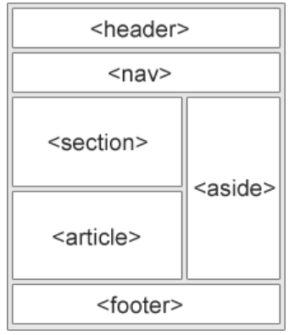
HTML5 Semantic Tags

Slide 13
<div>
The HTML Content Division element <div> is the generic container for flow content. It has no effect on the content or layout until styled using CSS
Source
https://developer.mozilla.org/en-US/docs/Web/HTML/Element/div

Slide 14
<span>
The HTML <span> element is a generic inline container for phrasing content which does not inherently represent anything. It can be used to group elements for styling purposes or because they share attribute values. <span> is much like a <div> element, but <div> is a block-level element whereas a <span> is an inline element
Source
https://developer.mozilla.org/en-US/docs/Web/HTML/Element/span

Slide 15
Block-Level Elements
A block-level element occupies the entire space of its parent element (container), thereby creating a "block". Browsers typically display the block-level element with a newline both before and after the element
e.g.: <form>, <hr>, <li>, <ol>, <p>, <table>, <ul>

Slide 16
Inline-Level Elements
Inline elements are those which only occupy the space bounded by the tags defining the element, instead of breaking the flow of the content. An inline element does not start on a new line and only takes up as much width as necessary
e.g.: <a>, <b>, <br>, <em>, <i>, <img>

Slide 17
<ol>
The HTML <ol> element represents an ordered list of items – typically rendered as a numbered list
<ol> Renders as:
<li>Element 1</li> 1. Element 1
<li>Element 2</li> 2. Element 2
</ol>
Source
https://developer.mozilla.org/en-US/docs/Web/HTML/Element/ol

Slide 18
<ul>
The HTML <ul> element represents an unordered list of items – typically rendered as a bulleted list
<ul> Renders as:
<li>An Element </li> • An element
<li>Another Element</li> • Another element
</ul>
Source
https://developer.mozilla.org/en-US/docs/Web/HTML/Element/ul

Slide 19
<form>
<form action=“val.js" method="POST/GET">…</form>
The HTML <form> element represents a document section containing interactive controls for submitting information
The action attribute is the URL that processes the form submission. The method attribute is used to submit the form via POST (method body) or GET (query string)
Source
https://developer.mozilla.org/en-US/docs/Web/HTML/Element/form

Slide 20
<form>
Major form tags:
input - Creates interactive form controls to accept user data
select - Creates a control that provides a menu of options
textarea - Creates a multi-line plain-text editing control
button - Creates a clickable (programmable) button
fieldset - Groups controls and labels within a web form
legend - Creates a caption for a corresponding fieldset

Slide 21
HTM <form> example
<form action="validate.js" method="POST">
<fieldset legend="Simple Form">
<input type="email" id="email" placeholder="Email Here"><br><br>
<select id="favpet">
<option value="">--Favorite pet--</option>
<option value="dog">Dog</option>
<option value="cat">Cat</option>
<option value="bird">Bird</option>
</select><br><br>
<button>Submit</button>
</fieldset>
</form>

Slide 22
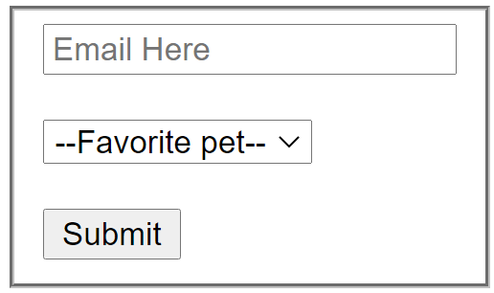
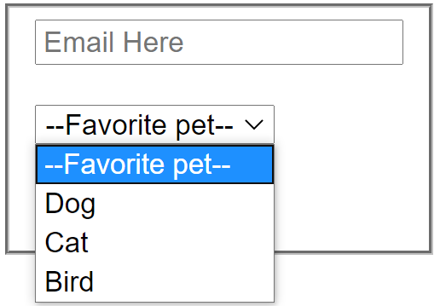
HTM <form> example
Added CSS:
<style>
fieldset {
display: inline-block;
}
</style>

Slide 23
What We Covered
HTML Document Structure
<!DOCTYPE html> Tag
<head> Section Tags
<body> Section Tags
HTML <form> Tag

Slide 24
Some Useful URLs
https://developer.mozilla.org/en-US/docs/Web/JavaScript
https://developer.mozilla.org/en-US/docs/Learn/Getting_started_with_the_web
https://www.w3schools.com/Html/

